Slide 1
Object Detection for Content Moderation
Daniel Russell, Honours Project, 2021

Slide 2
Introduction to Project
With the ever-increasing demand and user base on online social media, online forums, online trading and content creation sites the need for big and small companies to automate the process of content moderation greatly increase as the workload becomes too great for just human moderators to handle.
One way of automating the process of content moderation is via the use of object detection to detect illegal or hateful objects such as guns, hate symbols such as the swastika, etc.
The research question of this project : “What is the most efficient object detecting architecture that can be used to moderate content while requiring minimal training data and maintaining a relatively high degree of success?”
This project aims to answer the above stated research question via a “develop and test” methodology which requires a prototype that can be tested to reach a conclusion..

Slide 3
Summary of developed artefact
A prototype made on Google Colab making use of the TensorFlow Framework and its affiliated Object Detection API to develop, train and test three object detecting models.
The chosen object detecting architectures: Faster R-CNN, Efficient Det, RetinaNet.
Two dataset have been chosen for training and inference testing:
The first dataset for training is a Handgun dataset sourced from Roboflow.
The second dataset is a custom made gun dataset containing a mixture of toy guns, historical weapons, pistols and larger firearms for inference testing.

Slide 4
How everything relates to research question
The developed artefact aims to answer the research question by implementing the object detecting architectures (Faster R-CNN, Efficient Det, RetinaNet) to gather statistical data post training and during final inference testing.
Post training: via an evaluation script to calculate average precision, average recall of each model along with elapsed times during training
Final inference testing: for number of successful detections, confidence readings and elapsed times.

Slide 5
Datasets Detailed Discussion
Handgun Dataset available on Roboflow, uploaded by third party sourcing image data from an open dataset from DaSCI (Andalusian Research Institute in Data Science and Computational Intelligence) for the purposes of model training and evaluation.
Custom Gun Dataset created on Roboflow for the purposes of inference testing containing a mixture of toy guns, historical weapons, pistols and larger firearms for inference testing..
(Demo of both datasets will be provided further in the presentation)

Slide 6
Prototype Detailed Discussion
Implemented prototype is written in Python developed on Google Colab making use of the TensorFlow Framework and its affiliated Object Detection API.
Model weights of efficientdet_d0, ssd_resnet50 (RetinaNet), faster_rcnn_resnet50 from TensorFlow’s Model Zoo.
The two side scripts utilized from the Object Detection API:
Setup.py: Sets up the TensorFlow Framework in Google Colab
Model_builder_tf2_test.py: Conducts a series of tests on the installed Framework
The two main script utilized from the Object Detection API:
Model_main_tf2.py: Used for model training and evaluation
Exporter_main_v2.py: Used to export trained models
(Due to Google Colab limitations project was limited to 2000 steps for training and a maximum batch size of 5.)
(Further demo will be provided at the end of this presentation)

Slide 7
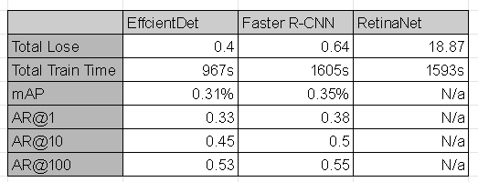
Results
Evaluation Testing. RetinaNet was unable to be fully evaluated during post-training.
Was Found Faster R-CNN Performed the best.

Slide 8
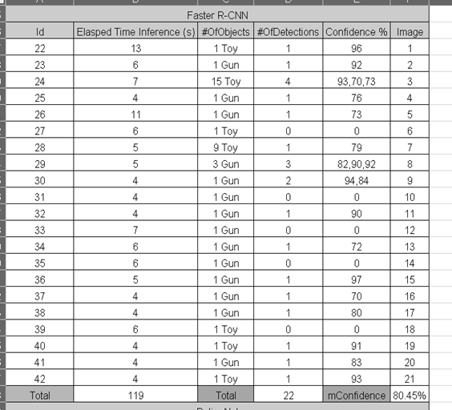
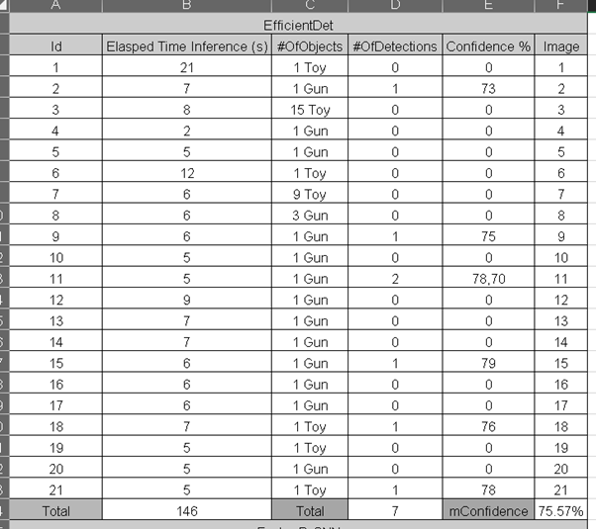
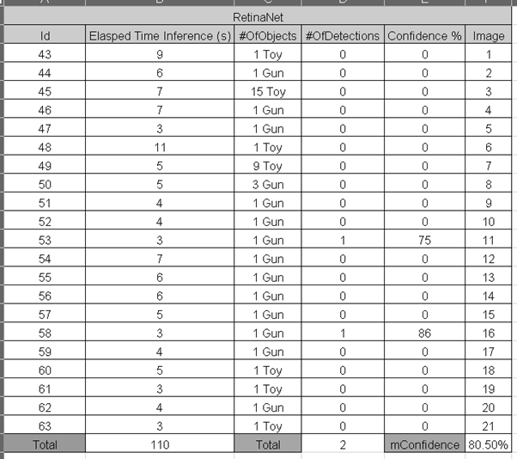
Results (Inference Testing)
Faster R-CNN performed the best
Notes:
#

Slide 9
Problems Encountered with Implementation
Google Colab’s resource(CPU, GPU, TPU) limitations
Google Colab’s time limits causing the prototype to timeout if executed for too long
Too low batch size and low number of steps to train effectively
RetinaNet was unable to be fully evaluated via script from an unknown cause
Google Colab was unable to save a copy of the previously trained models used in the report

Slide 10
Google Colab & Roboflow Showcase
The remained of the presentation will now showcase the sourced Handgun and custom made datasets from Roboflow as well as the implemented artefact as a notebook on Google Colab.

